Slide 1

Auto Mobile System

Slide 2
Group Members
Yekkitilli Sruthi 2000031821
Devineni Pooja 2000031641
Ainala Veera Brahmam 2000031763

Slide 3
AGENDA
USE CASE
MODULES
ANALYSIS
PROTOTYPE

Slide 4

Modules
Login page
Home Page
User Account
About Us
Support
Contact Us

Slide 5

HOME PAGE
A home page is a webpage that serves as the starting point of website. It is the default webpage that loads when you visit a web address that only contains a domain name. For example, visiting https://kluniversity.com will display the KL Universityhome page. The home page is located in the root directory of a website.

Slide 6
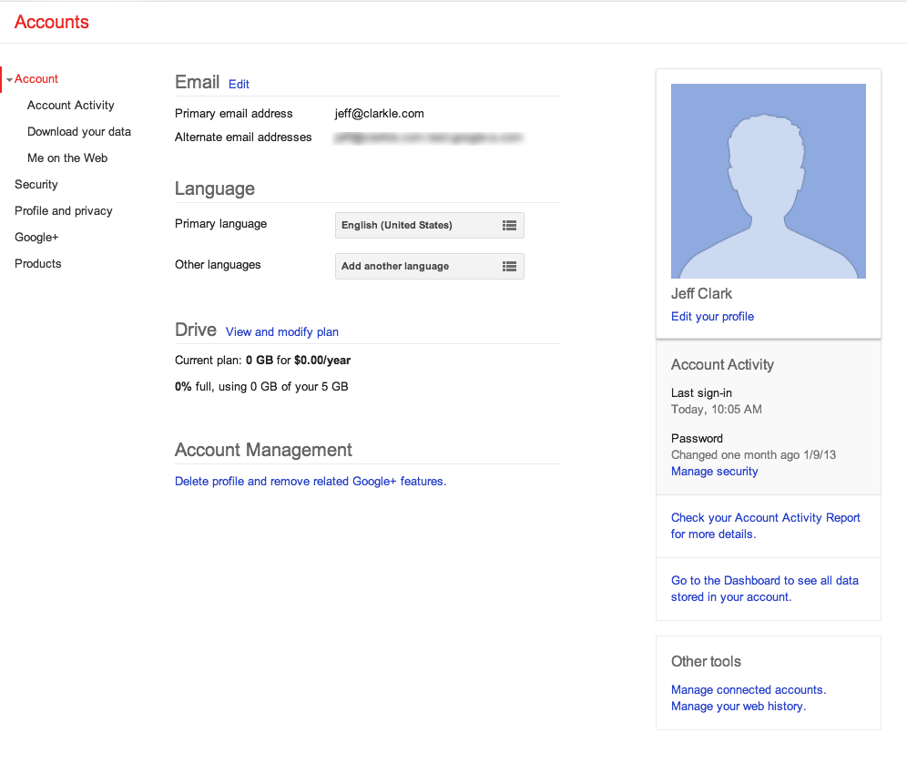
User Account
A user profile is a collection of settings and information associated with a user. It contains critical information that is used to identify an individual, such as their name, age, portrait photograph and individual characteristics such as knowledge or expertise.

Slide 7
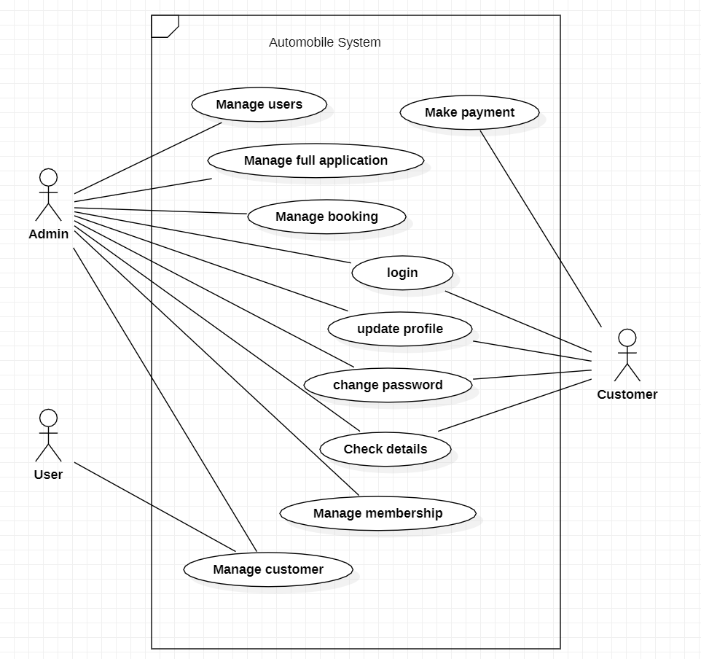
Use Case Diagram

Slide 8
Analysis
From the user feedback as the age of 18-25 are mostly responded we are doing our best to increase our level of user interface in this website.
This website is developing based on user needs to save their time with low of cost.
Feedback analysis involves identifying the needs and frustration of customers, so that our business can improve customer satisfaction and reduce churn.

Slide 9
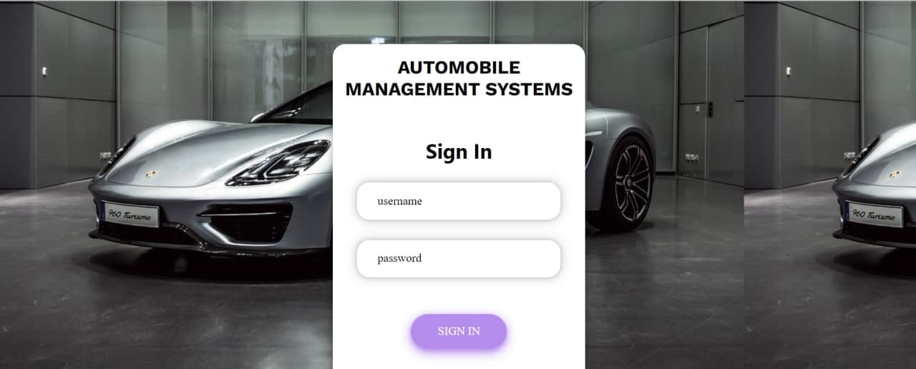
PROTOTYPE

